Slide 1
Multiplayer Reach-Avoid Games
Mo Chen, Zhengyuan Zhou, Claire Tomlin

Slide 2
Outline
Formulation
Maximum Matching Multiplayer Approach
Two player HJI solution
Two player path defense solution
Generalizations and extensions

Slide 3
Outline
Formulation
Maximum Matching Multiplayer Approach
Two player HJI solution
Two player path defense solution
Generalizations and extensions

Slide 4
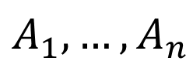

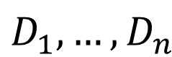

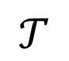
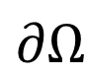
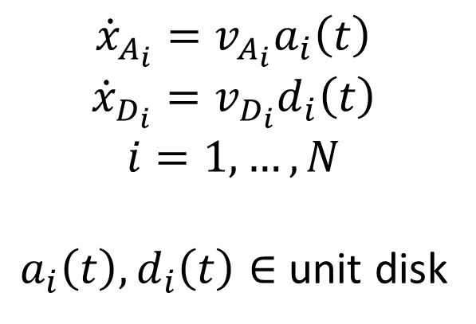
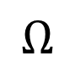
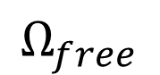
Formulation
Target
obstacle
defender
attacker
$$∂Ω$$
$$Ω_{free}$$
$$D_{1},…,D_{n}$$
$$Ω_{obs}$$
$$Ω$$
$$𝒯$$
$$A_{1},…,A_{n}$$
$$Ω_{obs}$$
$${\dot{x}}_{A_{i}}=v_{A_{i}}a_{i}\left(t\right)$$
$${\dot{x}}_{D_{i}}=v_{D_{i}}d_{i}\left(t\right)$$
$$i=1,…,N$$
$a_{i}\left(t\right),d_{i}\left(t\right)∈$ unit disk

Slide 5
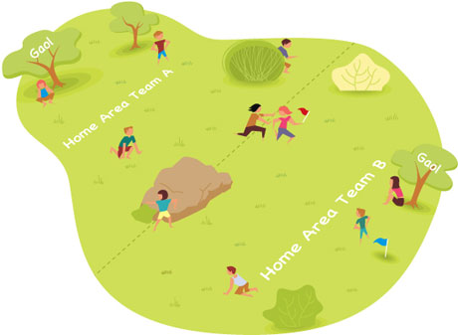
Why Multiplayer Reach-Avoid Games?
High dimensionality: Difficult to solve
Difficult to intuit
Humans sometimes play suboptimally even in a 1 vs. 1
Cooperation / Asymmetry
Applications in robotics and aircraft safety
http://playwithup.com/wp-content/uploads/2012/08/capture-the-flag-1.jpeg
Notes:
Multiplayer reach-avoid games are difficult to solve because of its high dimensionality. For example, if 10 players play on a 2D surface, their joint state space is 20 dimensions.
Despite the difficulty, it’s still important to find the optimal way to play, because even in a 1 vs 1 situation, humans intuition is suboptimal. This was demonstrated by work done previously in our lab, where two students played capture the flag against each other. One player had access to the calculated optimal control in real time, and the other player played based on intuition. The player who did not have the optimal control information lost the game even when he would have won if he played optimally.
With multiple players on each team, cooperation makes the game even more complex.
Applications of these games include safety in automated systems such as robots and aircrafts

Slide 6
Outline
Formulation
Maximum Matching Multiplayer Approach
Two player HJI solution
Two player path defense solution
Generalizations and extensions

Slide 7
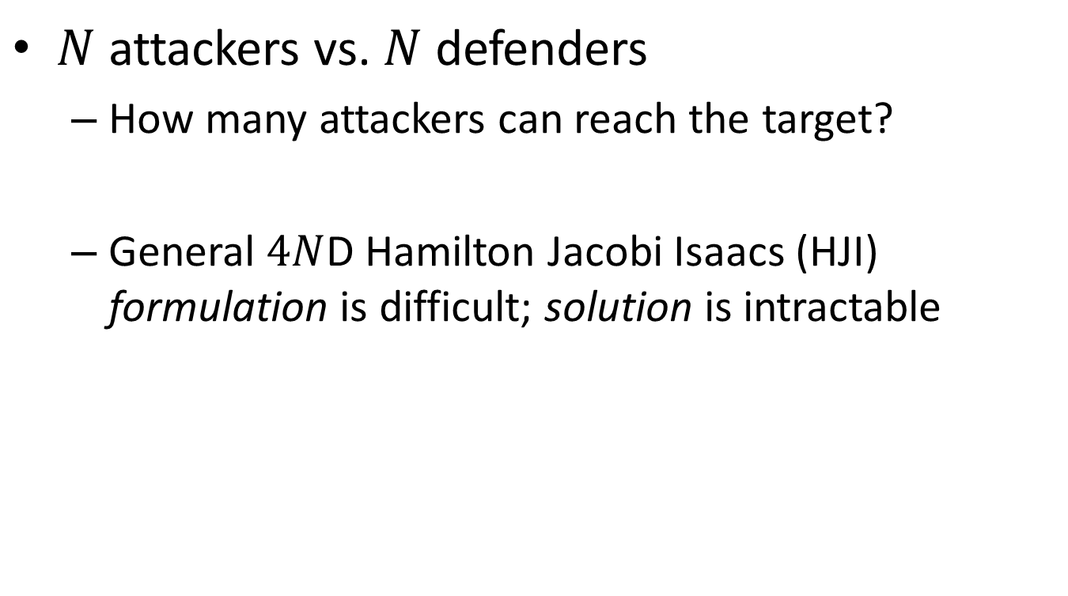
Multiplayer Reach-Avoid Game
$N$ attackers vs. $N$ defenders
How many attackers can reach the target?
General $4N$D Hamilton Jacobi Isaacs (HJI) formulation is difficult; solution is intractable

Slide 8
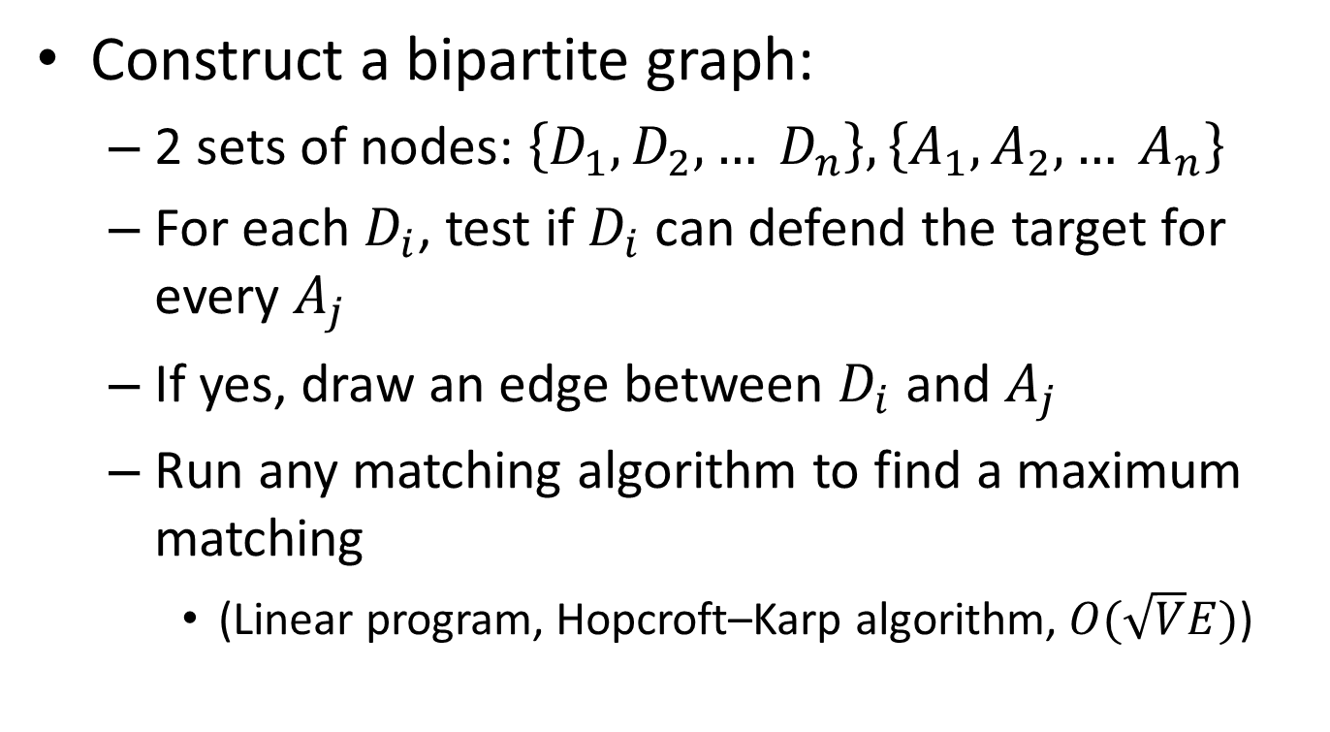
From Two Player to Multiplayer
Construct a bipartite graph:
2 sets of nodes: $\left\{D_{1}, D_{2}, … D_{n}\right\},\left\{A_{1},A_{2},… A_{n}\right\}$
For each $D_{i}$, test if $D_{i}$ can defend the target for every $A_{j}$
If yes, draw an edge between $D_{i}$ and $A_{j}$
Run any matching algorithm to find a maximum matching
(Linear program, Hopcroft–Karp algorithm, $O(\sqrt{V}E)$)

Slide 9
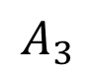
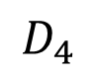
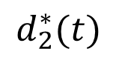
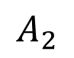
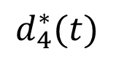
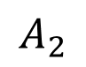
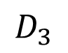
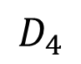
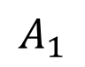
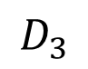
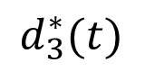
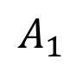
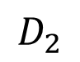
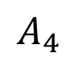
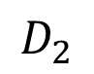
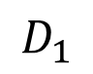
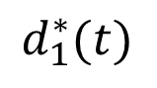
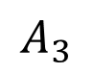
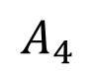
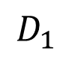
Two-player game to multiplayer game
Two player solutions
$$A_{1}$$
$$D_{1}$$
$$A_{1}$$
$$d_{2}^{∗}(t)$$
$$D_{1}$$
$$A_{2}$$
$$D_{2}$$
$$A_{2}$$
Maximum matching
$$D_{2}$$
$$d_{1}^{∗}(t)$$
$$A_{3}$$
$$d_{3}^{∗}(t)$$
$$D_{3}$$
$$A_{3}$$
$$D_{3}$$
$$d_{4}^{∗}(t)$$
$$A_{4}$$
$$D_{4}$$
$$A_{4}$$
$$D_{4}$$

Slide 10
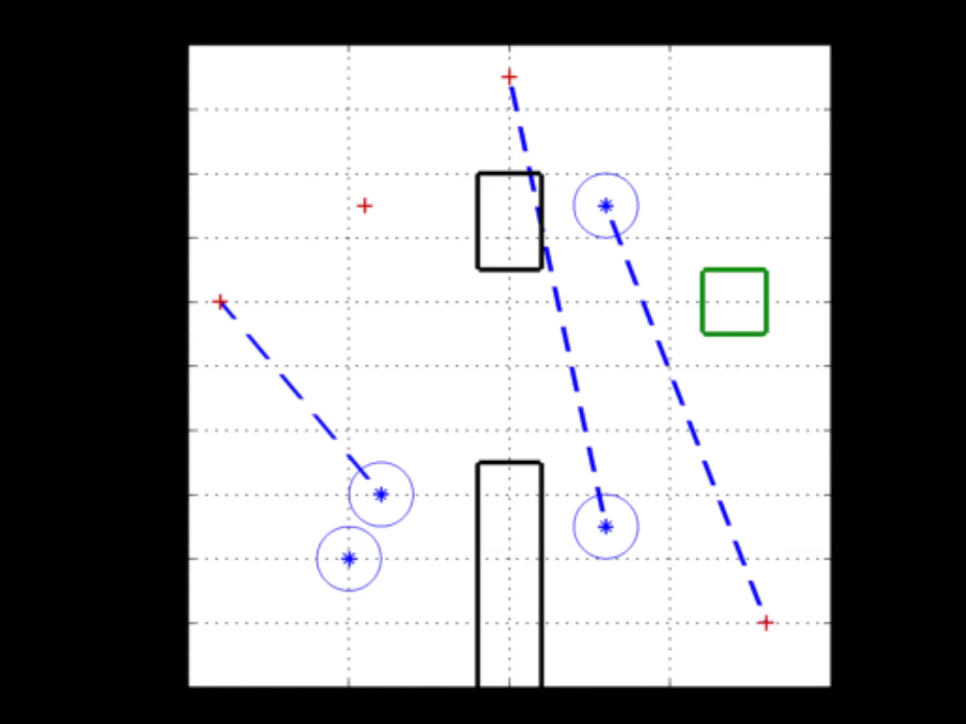
Maximum Matching
Notes:
The maximum matching can be computed in real time as the players play out the game. Often, the size of the maximum matching will increase as the players play out the game, as shown in this simulation.
The blue stars are defenders, the red crosses are attackers, the black rectangles are obstacles and the green square is the target set.

Slide 11
Outline
Formulation
Maximum Matching Multiplayer Approach
Two player HJI solution
Two player path defense solution
Generalizations and extensions

Slide 12
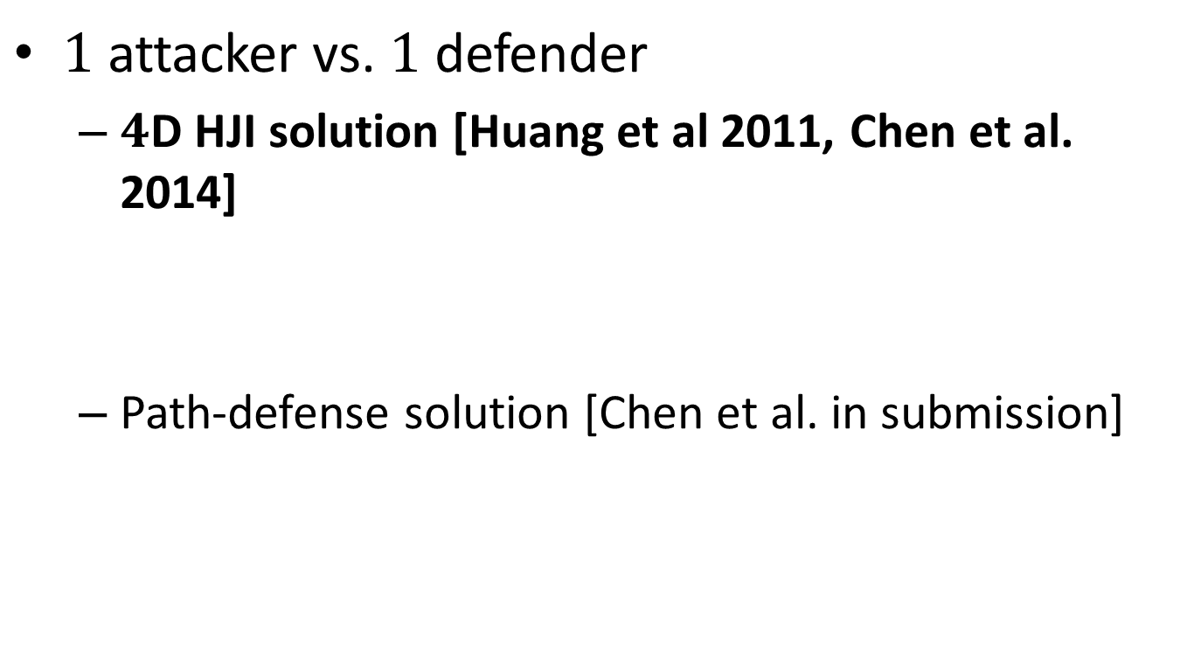
Two Player Game
$1$ attacker vs. $1$ defender
$4$D HJI solution [Huang et al 2011, Chen et al. 2014]
Path-defense solution [Chen et al. in submission]

Slide 13
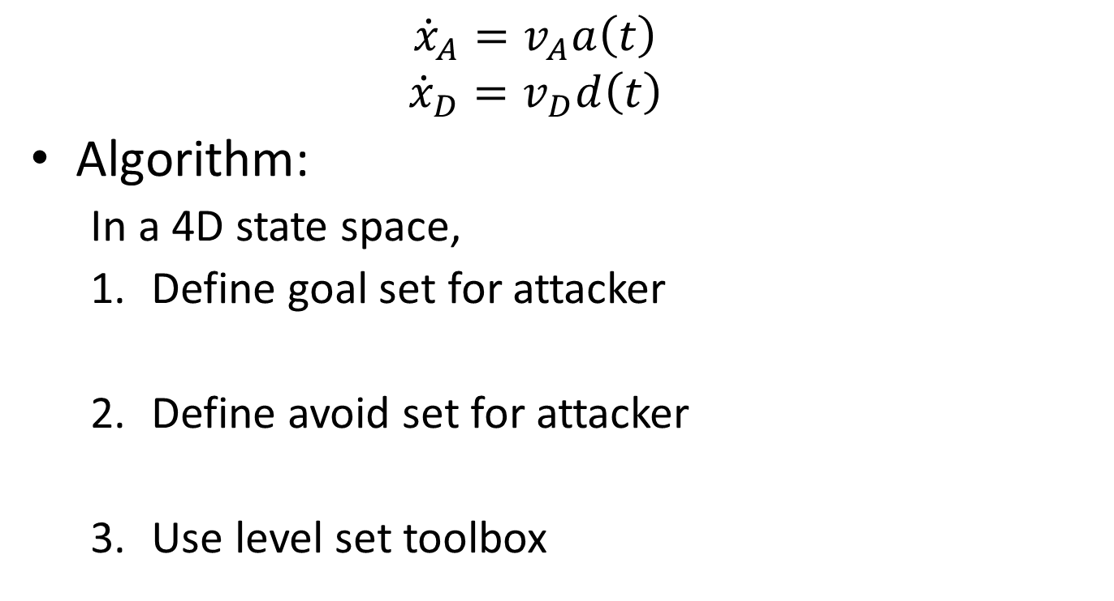
4D HJI Solution
$${\dot{x}}_{A}=v_{A}a\left(t\right)$$
$${\dot{x}}_{D}=v_{D}d\left(t\right)$$
Algorithm:
In a 4D state space,
Define goal set for attacker
Define avoid set for attacker
Use level set toolbox

Slide 14
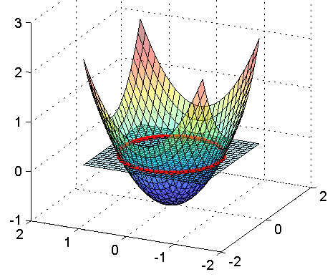
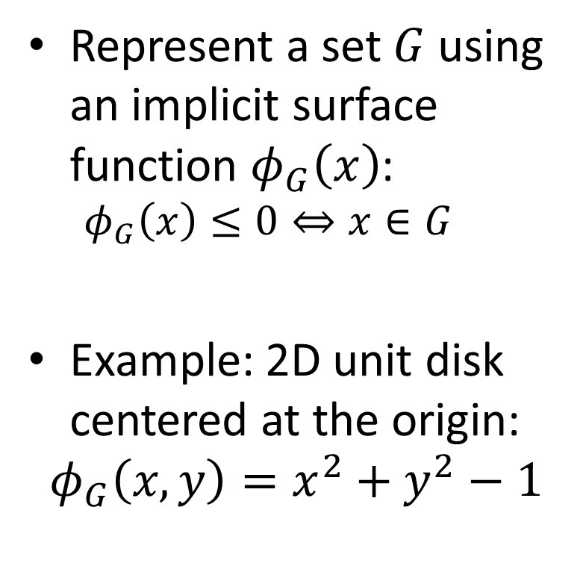
Defining sets
Represent a set $G$ using an implicit surface function $φ_{G}\left(x\right)$:
$$φ_{G}\left(x\right)≤0⇔x∈G$$
Example: 2D unit disk centered at the origin:
$$φ_{G}\left(x,y\right)=x^{2}+y^{2}−1$$

Slide 15
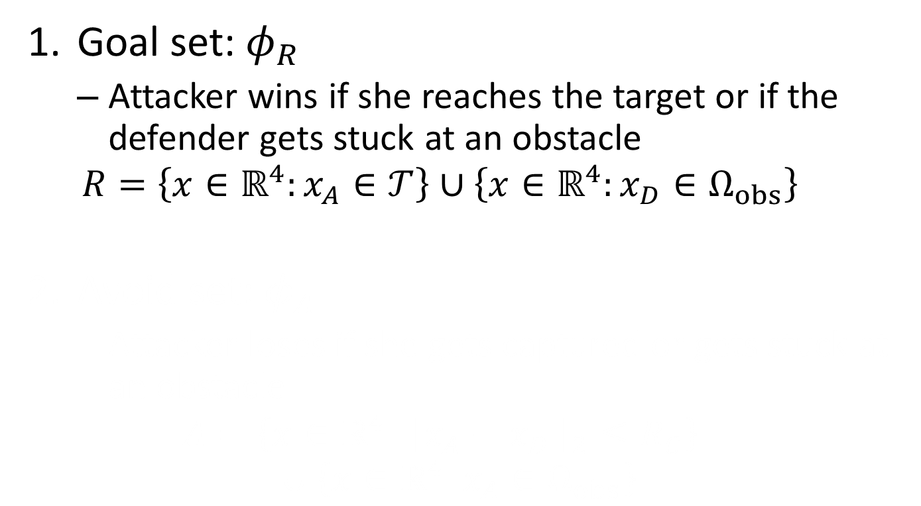
Defining sets
Goal set: $φ_{R}$
Attacker wins if she reaches the target or if the defender gets stuck at an obstacle
$$R=\left\{x∈ℝ^{4}:x_{A}∈𝒯\right\}∪\left\{x∈ℝ^{4}:x_{D}∈Ω_{obs}\right\}$$
Avoid set: $φ_{A}$
Attacker loses if she gets captured or gets stuck at an obstacle
$$A=\left\{x∈ℝ^{4}:{\left\|x_{A}−x_{D}\right\|}_{2}≤R_{C}\right\}∪\left\{x∈ℝ^{4}:x_{A}∈Ω_{obs}\right\}$$
Notes:
7:00

Slide 16
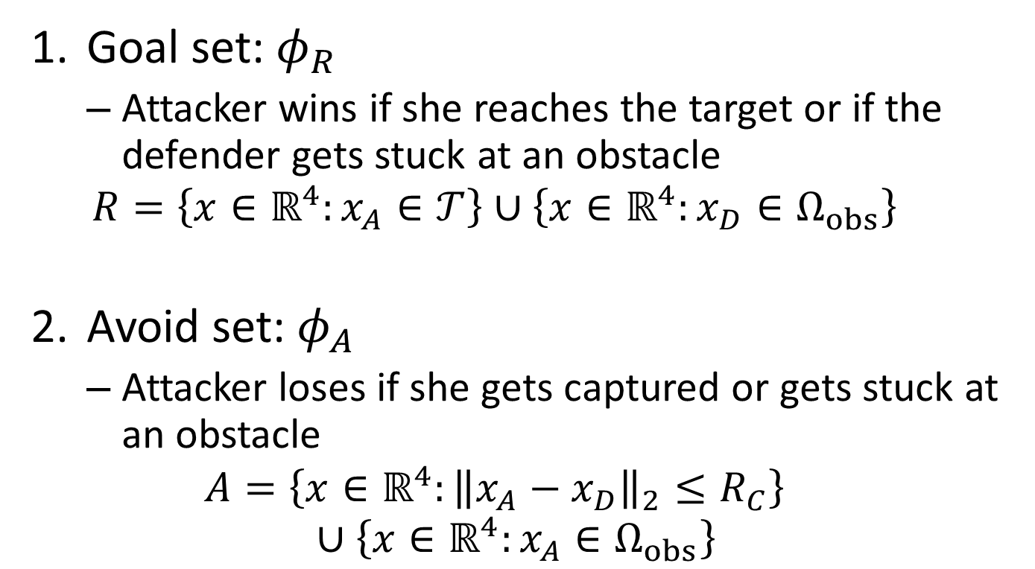
Defining sets
Goal set: $φ_{R}$
Attacker wins if she reaches the target or if the defender gets stuck at an obstacle
$$R=\left\{x∈ℝ^{4}:x_{A}∈𝒯\right\}∪\left\{x∈ℝ^{4}:x_{D}∈Ω_{obs}\right\}$$
Avoid set: $φ_{A}$
Attacker loses if she gets captured or gets stuck at an obstacle
$$A=\left\{x∈ℝ^{4}:{\left\|x_{A}−x_{D}\right\|}_{2}≤R_{C}\right\}∪\left\{x∈ℝ^{4}:x_{A}∈Ω_{obs}\right\}$$
Notes:
7:00

Slide 17
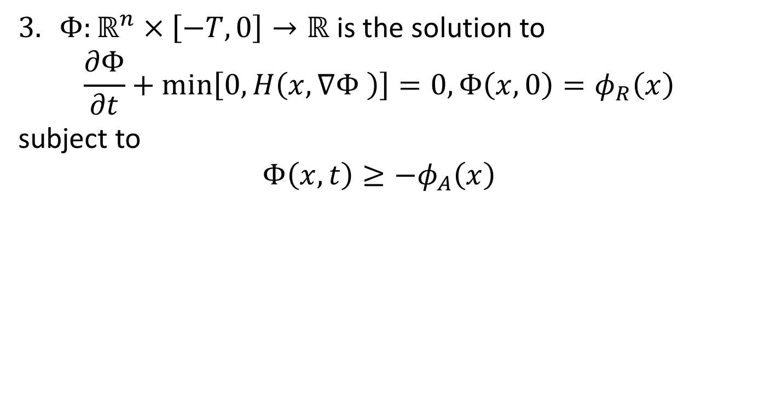
Level set toolbox: solve HJI PDE
$Φ:ℝ^{n}×\left[−T,0\right]→ℝ$ is the solution to
$$\frac{∂Φ}{∂t}+min\left[0,H\left(x,∇Φ \right)\right]=0,Φ\left(x,0\right)=φ_{R}\left(x\right)$$
subject to
$$Φ\left(x,t\right)≥−φ_{A}\left(x\right)$$
where the Hamiltonian is given by
$$H\left(x,p\right)=\min_{a}{\max_{d}{p^{T}f\left(x,a,d\right)}}$$
In our case with decoupled dynamics, order of min and max doesn’t matter (Isaac’s condition holds)
Notes:
9:00

Slide 18
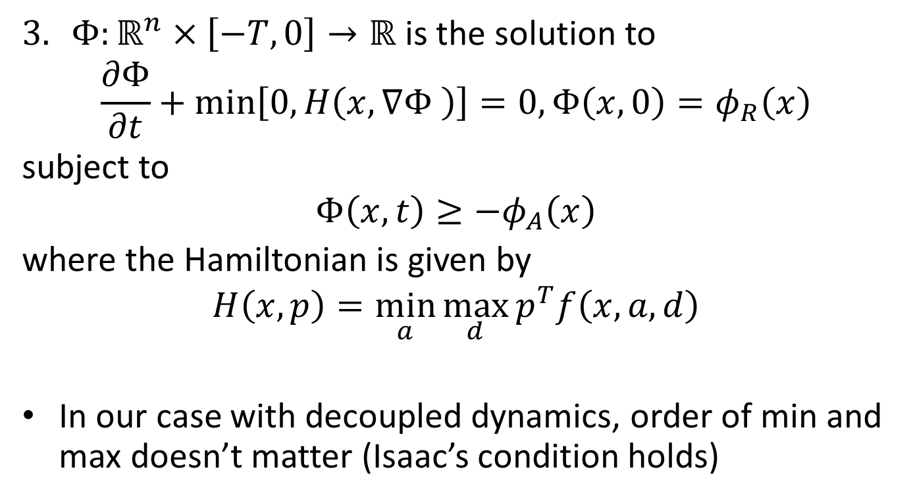
Level set toolbox: solve HJI PDE
$Φ:ℝ^{n}×\left[−T,0\right]→ℝ$ is the solution to
$$\frac{∂Φ}{∂t}+min\left[0,H\left(x,∇Φ \right)\right]=0,Φ\left(x,0\right)=φ_{R}\left(x\right)$$
subject to
$$Φ\left(x,t\right)≥−φ_{A}\left(x\right)$$
where the Hamiltonian is given by
$$H\left(x,p\right)=\min_{a}{\max_{d}{p^{T}f\left(x,a,d\right)}}$$
In our case with decoupled dynamics, order of min and max doesn’t matter (Isaac’s condition holds)
Notes:
9:00

Slide 19
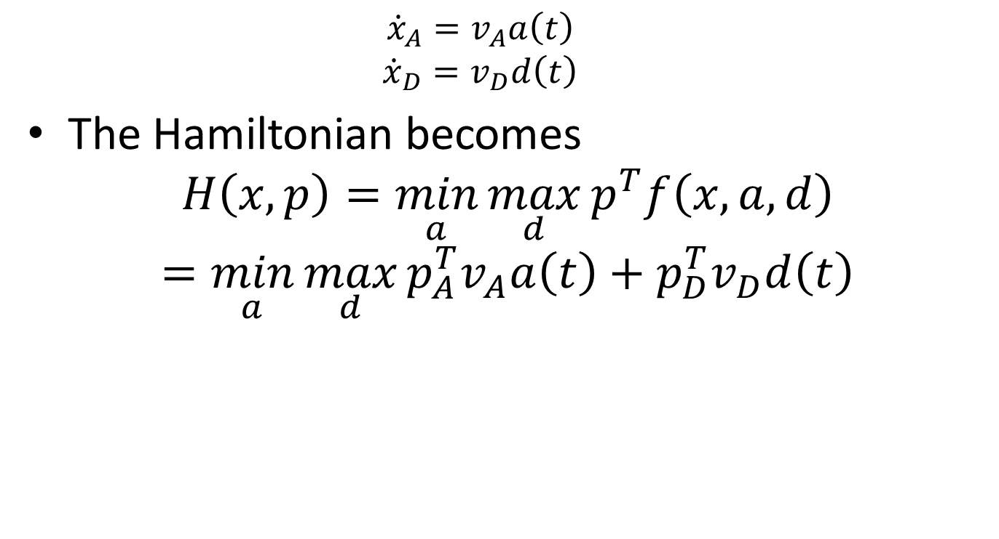
The Hamiltonian
$${\dot{x}}_{A}=v_{A}a\left(t\right)$$
$${\dot{x}}_{D}=v_{D}d\left(t\right)$$
The Hamiltonian becomes
$$H\left(x,p\right)=\min_{a}{\max_{d}{p^{T}f\left(x,a,d\right)}}$$
$$=\min_{a}{\max_{d}{p_{A}^{T}v_{A}a\left(t\right)+p_{D}^{T}v_{D}d\left(t\right)}}$$
Performing the maximization, we have
$$H\left(x,p\right)=−v_{A}{\left\|p_{A}^{T}\right\|}_{2}+v_{D}{\left\|p_{D}^{T}\right\|}_{2}$$
Notes:
11:00

Slide 20
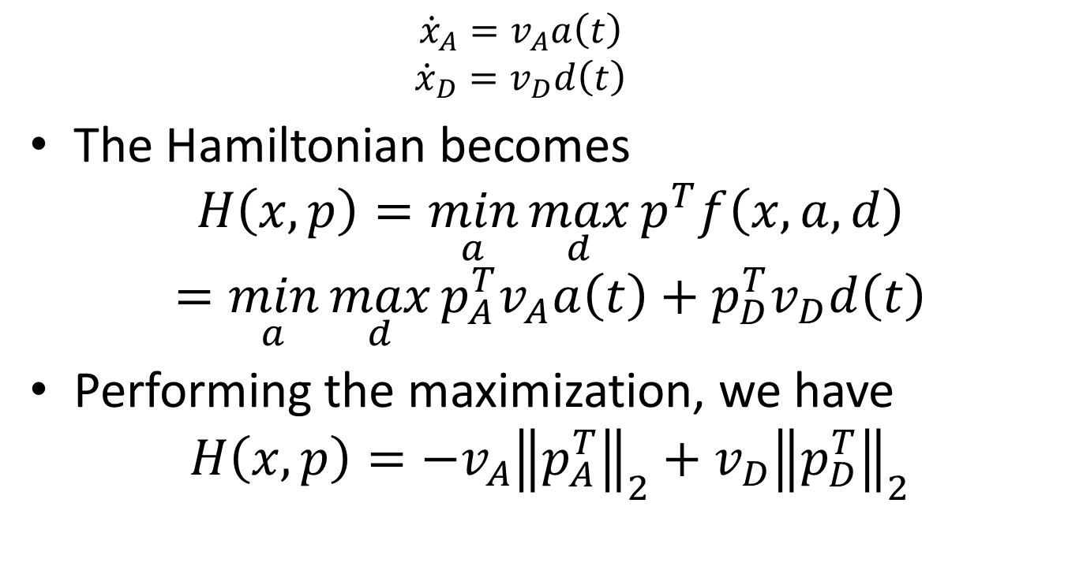
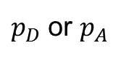
The Hamiltonian
$${\dot{x}}_{A}=v_{A}a\left(t\right)$$
$${\dot{x}}_{D}=v_{D}d\left(t\right)$$
The Hamiltonian becomes
$$H\left(x,p\right)=\min_{a}{\max_{d}{p^{T}f\left(x,a,d\right)}}$$
$$=\min_{a}{\max_{d}{p_{A}^{T}v_{A}a\left(t\right)+p_{D}^{T}v_{D}d\left(t\right)}}$$
Performing the maximization, we have
$$H\left(x,p\right)=−v_{A}{\left\|p_{A}^{T}\right\|}_{2}+v_{D}{\left\|p_{D}^{T}\right\|}_{2}$$
$p_{D}$ or $p_{A}$
Notes:
11:00

Slide 21
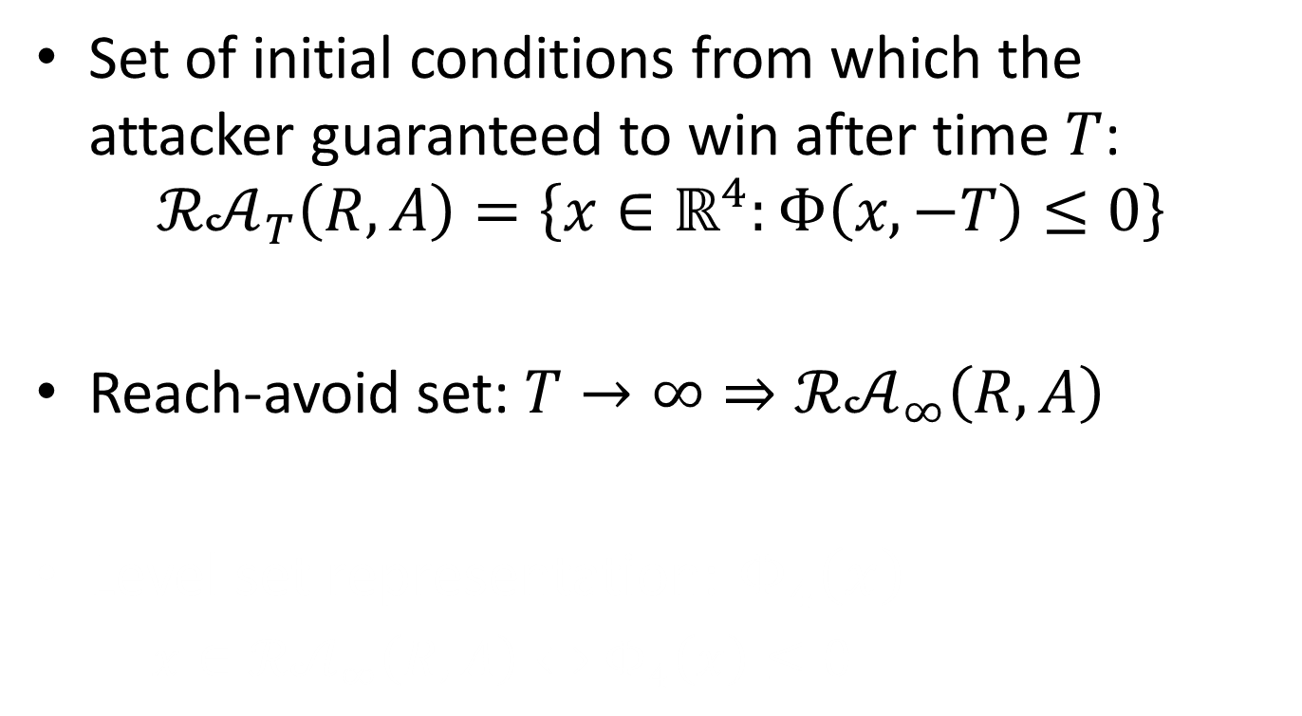
Solution to the 4D HJI PDE
Set of initial conditions from which the attacker guaranteed to win after time $T$:
$$ℛ𝒜_{T}\left(R,A\right)=\left\{x∈ℝ^{4}:Φ\left(x,−T\right)≤0\right\}$$
Reach-avoid set: $T→∞⇒ℛ𝒜_{∞}\left(R,A\right)$
Level set representation: $Φ_{4}\left(x\right)$
$x∈ℛ𝒜_{∞}\left(R,A\right)⇔$ $Φ_{4}\left(x\right)≤0$
Notes:
12:00
Explain interpretation of $Φ_{4}$

Slide 22
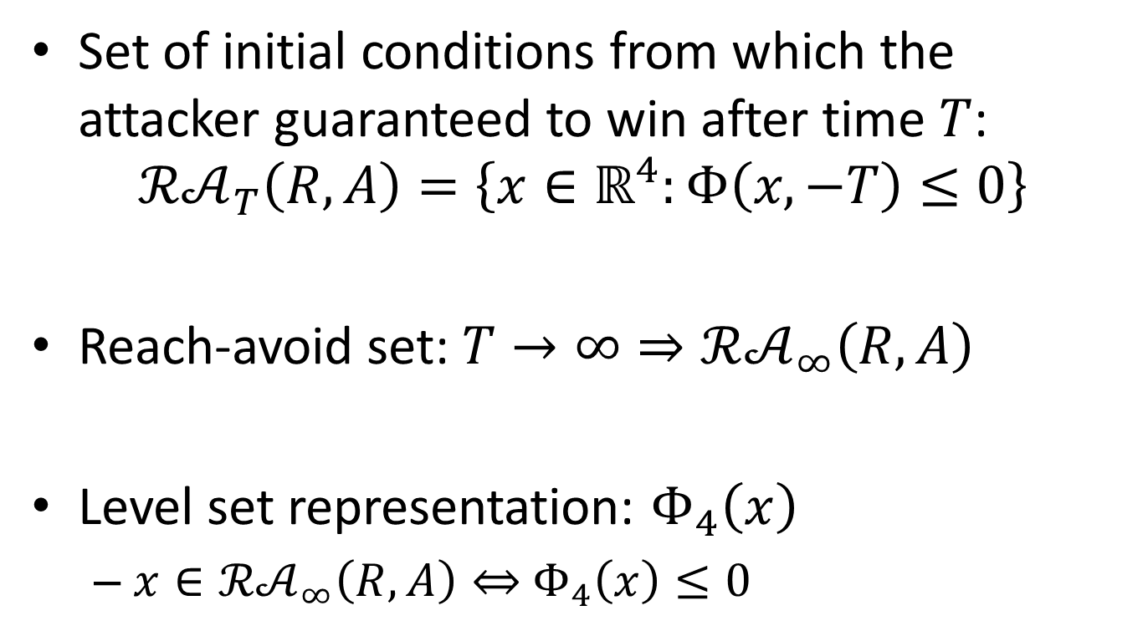
Solution to the 4D HJI PDE
Set of initial conditions from which the attacker guaranteed to win after time $T$:
$$ℛ𝒜_{T}\left(R,A\right)=\left\{x∈ℝ^{4}:Φ\left(x,−T\right)≤0\right\}$$
Reach-avoid set: $T→∞⇒ℛ𝒜_{∞}\left(R,A\right)$
Level set representation: $Φ_{4}\left(x\right)$
$x∈ℛ𝒜_{∞}\left(R,A\right)⇔$ $Φ_{4}\left(x\right)≤0$
Notes:
12:00
Explain interpretation of $Φ_{4}$

Slide 23
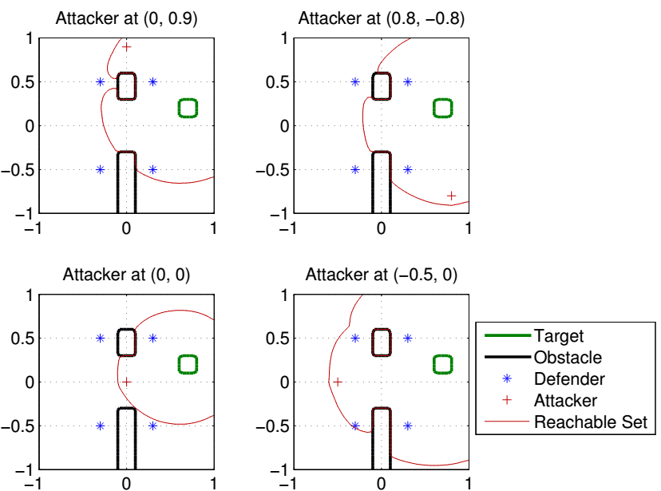
Results: reach-avoid slices

Slide 24
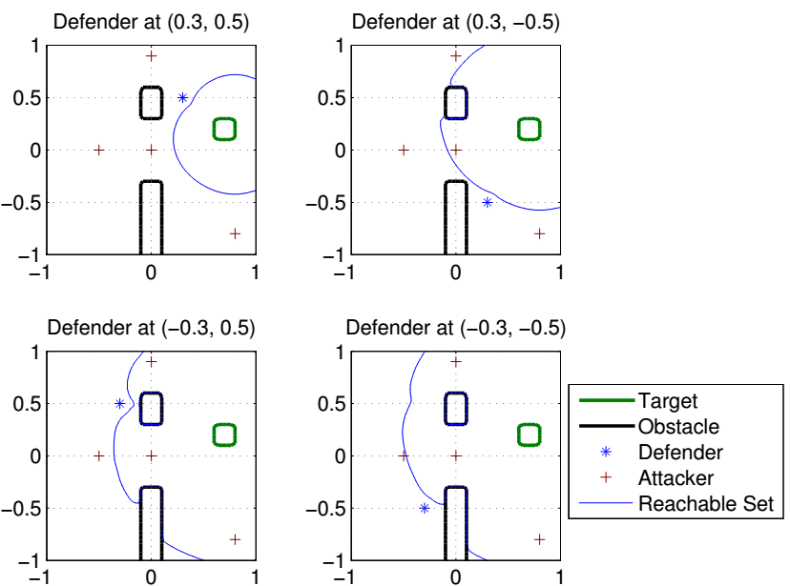
Results : reach-avoid slices

Slide 25
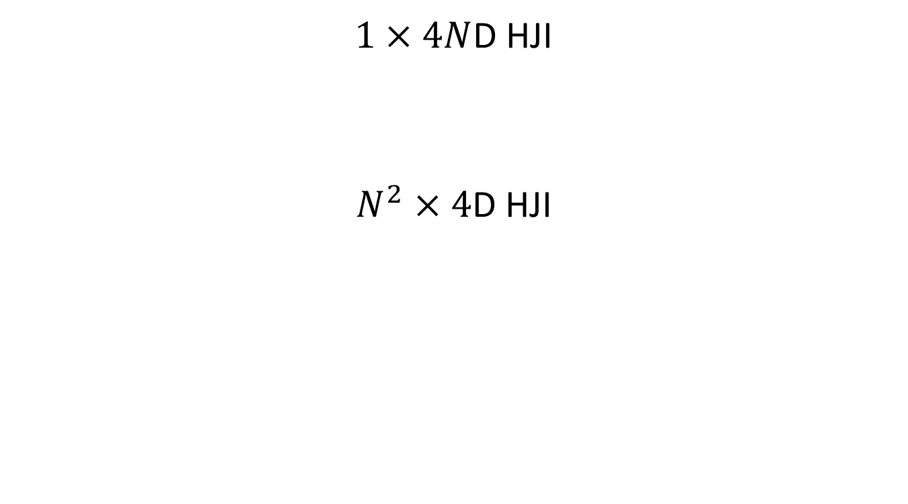
Multiplayer Complexity Reduction
$1×4N$D HJI
$N^{2}×4$D HJI

Slide 26
Outline
Formulation
Maximum Matching Multiplayer Approach
Two player HJI solution
Two player path defense solution
Generalizations and extensions

Slide 27
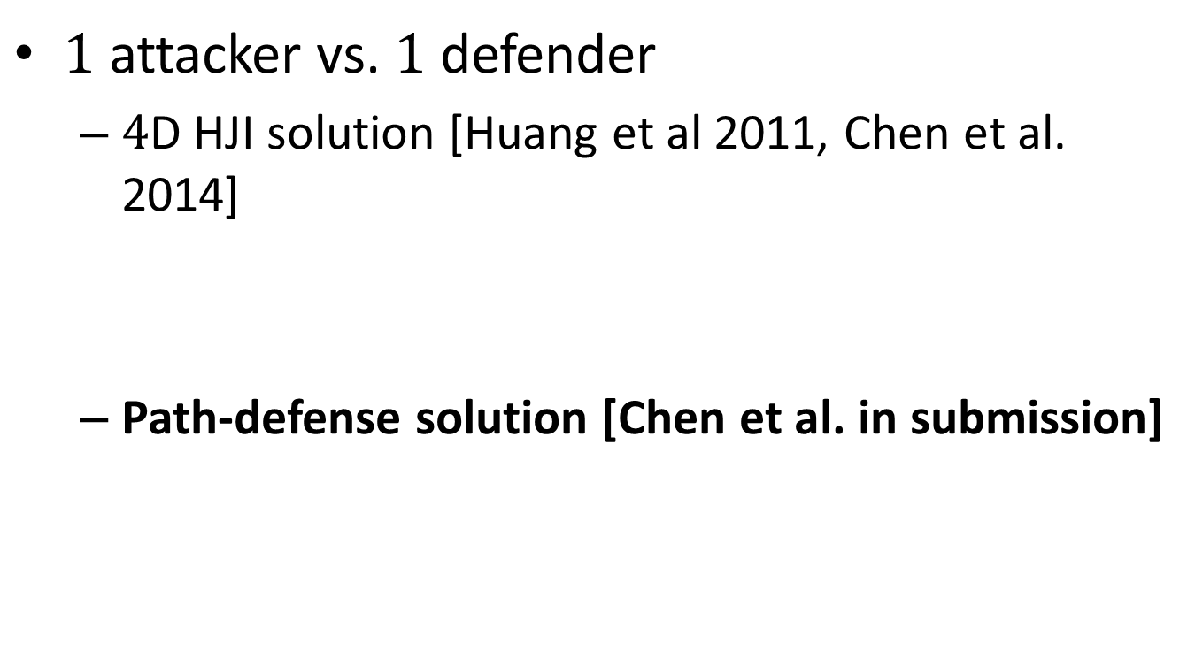
Two Player Game
$1$ attacker vs. $1$ defender
$4$D HJI solution [Huang et al 2011, Chen et al. 2014]
Path-defense solution [Chen et al. in submission]

Slide 28
Reach-avoid slice
Compute reach-avoid slices at the attacker positions
For every attacker position, a single computation is sufficient for all defender speeds.

Slide 29
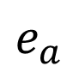
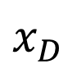


Path Defense Game
target
defender
attacker
$$e_{a}$$
$$x_{D}$$
$$x_{A}$$
$$e_{b}$$
Notes:
Mention defender has to get on the path

Slide 30








Starting on the path
$$e_{a}$$
target
attacker
attacker level set image
defender arrival point
$$𝒯$$
$$x_{A}^{′}\left(e_{a}\right)$$
$$ℛ_{a}$$
$$p$$
$$x_{A}$$
$$ℛ_{b}$$
$$e_{b}$$

Slide 31









Starting on the path
$$e_{a}$$
target
attacker
defender arrival point
attacker crossing point
$$𝒯$$
$$p$$
$$ℛ_{a}$$
$$p^{′}$$
$$e_{b}$$
$$ℛ_{b}$$
$$d\left(x_{A},e_{b}\right)≤d\left(x_{A},p^{′}\right)+d\left(p^{′},e_{b}\right)$$
$$<d\left(p,p^{′}\right)+d\left(p^{′},e_{b}\right)$$
$$=d\left(p,e_{b}\right)$$
$$<d\left(x_{A},e_{b}\right)$$
$$x_{A}$$

Slide 32








Best arrival point
target
defender
attacker
best arrival point
candidate best arrival point
$$ℛ_{a}\left(p^{∗}\right)$$
$$x_{D}$$
$$p^{∗}$$
$$p^{′}$$
$$ℛ_{a}\left(p^{′}\right)$$
$$ℛ_{b}\left(p^{′}\right)$$
$$x_{A}$$
$$ℛ_{b}\left(p^{∗}\right)$$

Slide 33






Defender winning region
$$𝒯$$
target
Attacker
defender winning region
best arrival point
$$ℛ_{a}$$
$$p^{∗}$$
$$𝒟$$
$$ℛ_{b}$$
$$x_{A}$$

Slide 34







Computing defender winning region
Find $p^{∗}$
Compute induced $ℛ_{a},ℛ_{b}$
Compute $𝒟$, the defender winning region for this path
$$𝒯$$
$$ℛ_{a}$$
$$p^{∗}$$
$$𝒟$$
$$ℛ_{b}$$
$$x_{A}$$

Slide 35

Computing defender winning region

Slide 36

Computing reach-avoid slice
For a path, find $p^{∗}$
Compute induced regions $ℛ_{a},ℛ_{b}$
Compute $𝒟$, winning region for the path
Repeat for many paths and take union of $𝒟$’s $⇒$ reach-avoid slice

Slide 37

Computing reach-avoid slice

Slide 38

Results

Slide 39

Number of paths

Slide 40

Number of paths

Slide 41



Scaling up to $N$ vs. $N$
Compute the set of paths
For every path
find $p^{∗}$
Compute induced $ℛ_{a},ℛ_{b}$
Compute $𝒟$
Repeat 1 and 2 for every attacker

Slide 42

Scaling up to $N$ vs. $N$
Compute the set of paths
For every path
find $p^{∗}$
Compute induced $ℛ_{a},ℛ_{b}$
Compute $𝒟$
Repeat 1 and 2 for every attacker

Slide 43

Multiplayer Complexity Reduction
$1×4N$D HJI
$N^{2}×4$D HJI
$O\left(N\right)×2$D Eikonal

Slide 44
Outline
Formulation
Maximum Matching Multiplayer Approach
Two player HJI solution
Two player path defense solution
Generalizations and extensions

Slide 45
Extensions
Elements of path defense
Optimal paths / time to reach functions
Notion of level set image
Strong path defense

